Slide 1
ECON F355 Assignment
By Group 14

Slide 2
GROUP MEMBERS
Name | ID Number
SARTHAK AGARWAL | 2021A4PS3087H
AMOL BIMLESH AUDICHYA | 2021A7PS1830H
CHIRAG NANDA | 2021A1PS3052H
SONAKSHI SHARAN | 2021A8PS3002H
JAYANTH REDDY NAREDDY | 2021A4PS1620H
SAIRA DAS | 2020B3A31498H
MD ASHFAAQ KHAN | 2021A3PS2687H

Slide 3
About M&M
Mahindra & Mahindra Limited (M&M) is an Indian multinational automotive manufacturing corporation headquartered in Mumbai.
Originally founded as Mahindra & Mohammed in 1945, it subsequently changed its name to Mahindra & Mahindra.
It ranks among India's top vehicle manufacturers in terms of output
By volume, Mahindra Tractors, one of its divisions, is the biggest tractor manufacturer worldwide.
In 2018, Fortune India 500 placed it at number 17 on their list of the top companies in India.
Their manufacturing facilities are located in the US, France, Finland, India, Japan, China, Australia, and Africa
In addition to India, M&M has operations in South Korea, Japan, Italy, and North America

Slide 4
Industry Data
M&M belongs to the automotive industry and is a prominent manufacturer of trucks, farm tractors, and sport utility vehicles.
Originally established as a steel trade company, it shortly started producing four-wheel-drive cars after gaining independence, and thanks to the success of the auto industry, it progressively grew its empire.
In the 2000s, the company's SUVs were well-received, which strengthened its position in the passenger car market. It acquired South Korean carmaker Ssangyong Motor in 2010.
It also acquired domestic startups and became the first Indian company to market electric vehicles.

Slide 5
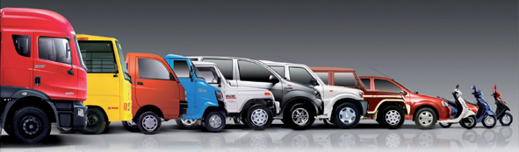
Products and Services
M&M offers a wide range of products and solutions ranging from
SUVs to electric vehicles,
pickups,
commercial vehicles,
tractors,
two-wheelers and
construction equipment.
Being a diversified business company, apart from automotive, it also has its presence in industries such as aerospace, agri-business, aftermarket, information technology, consulting, components, clean energy, financial services, defense, real estate and infrastructure, retail, steel, hospitality, IT services, investments and logistics.

Slide 6
Sources of Revenue
Mahindra & Mahindra Limited (M&M) generates revenue from various business segments.The major sources of revenue for Mahindra & Mahindra include:
Automotive Segment: Sales of utility vehicles, including popular models like Thar, Scorpio, XUV500, and Bolero.
Farm Equipment Segment: Sales of tractors, agricultural machinery and implements.
Financial Services Segment: Revenue generated through Tech Mahindra, the IT services subsidiary along with IT consulting services and Business process outsourcing services.
Other Business Segments: Aerospace, Hospitality and Real Estate.

Slide 7
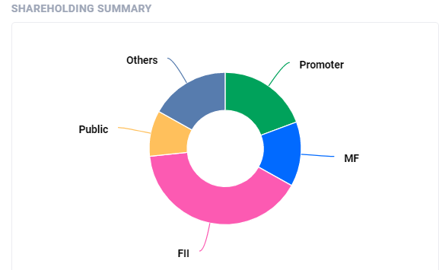
19.3
Promoter holding %
0.1
Promoter pledges %
40.3
FII holding current Qtr %
13.7
MF holding current Qtr %
67.1
Institutions holding %

Slide 8
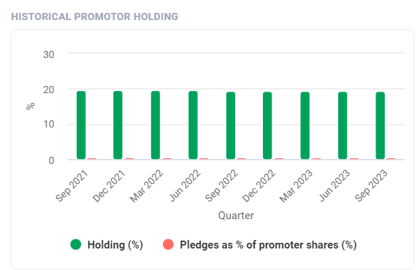
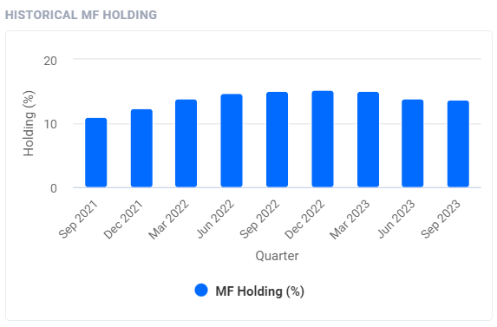
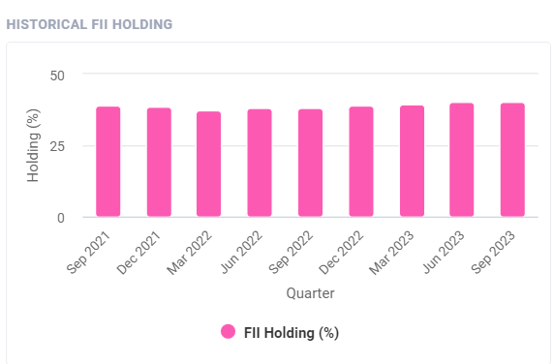

Slide 9
SHAREHOLDING PATTERN
Summary | Sep 2023 | Jun 2023 | Mar 2023 | Dec 2022 | Sep 2022 | Jun 2022 | Mar 2022 | Dec 2021 | Sep 2021 | Jun 2021 | Mar 2021 | Dec 2020
Promoter | 19.3% | 19.4% | 19.4% | 19.4% | 19.4% | 19.5% | 19.5% | 19.5% | 19.5% | 19.5% | 19.5% | 19.4%
FII | 40.3% | 40.1% | 39.2% | 39.2% | 38.3% | 37.9% | 37.3% | 38.7% | 38.9% | 40.1% | 38.9% | 37.9%
DII | 26.9% | 27.0% | 27.7% | 27.8% | 28.6% | 29% | 28.9% | 27.9% | 27.2% | 26.2% | 27.6% | 28.5%
Public | 9.7% | 9.7% | 9.8% | 9.8% | 9.8% | 9.7% | 10.4% | 10.0% | 10.4% | 10.2% | 9.9% | 10.0%
Others | 3.8% | 3.8% | 3.9% | 3.9% | 4.0% | 4.0% | 4.0% | 4.0% | 4.1% | 4.1% | 4.1% | 4.2%

Slide 10
Stakeholders
Name | Equities | % | Valuation
Prudential Management & Services Pvt Ltd. | 141,521,940 | 11.38 % | 2 479 M ₹
Mahindra & Mahindra Benefit Trust | 84,470,428 | 6.793 % | 1 480 M ₹
Life Insurance Corporation of India (Investment Portfolio) | 68,936,077 | 5.544 % | 1 208 M ₹
First Sentier Investors (Australia) IM Ltd. | 54,933,858 | 4.418 % | 962 M ₹
SBI Funds Management Ltd. | 47,015,345 | 3.781 % | 824 M ₹
The Vanguard Group, Inc. | 36,408,463 | 2.928 % | 638 M ₹
GIC Pte Ltd. (Investment Management) | 25,215,427 | 2.028 % | 442 M ₹
HDFC Asset Management Co. Ltd. (Invt Mgmt) | 22,548,388 | 1.813 % | 395 M ₹
Norges Bank Investment Management | 20,415,424 | 1.642 % | 358 M ₹
National Pension System Trust | 17,781,077 | 1.430 % | 312 M ₹

Slide 11
Members of the Board | Title | Since
Anand Gopal Mahindra | Chairman | 1988
Shikha Sharma | Director/Board Member | 2019
Vishakha N.Desai | Director/Board Member | 2012
Nisaba Adi Godrej | Director/Board Member | 2020
Rajesh Ganesh Jejurikar | Director/Board Member | 1999
Thothala Manoharan | Director/Board Member | 2016
Chander Prakash Gurani | Director/Board Member | 2020
Vikram Singh Mehta | Director/Board Member | 2012
Vijay kumar Sharma | Director/Board Member | 2018
Anish Dilip shah | Director/Board Member | 2014

Slide 12
Competitors
1. Tata Motors:
Tata Motors is headquartered in Mumbai, India and is an Indian automotive manufacturing company. Its products ranges from trucks, cars, passenger vans, buses military vehicles and construction equipment. Tata Motors was founded in the year 1945 as locomotive manufacturer and in collaboration with Daimler-Benz AG it’s manufactured its first commercial vehicle in 1954.
2. Maruti Suzuki:
Subsidiary of the Japanese automotive manufacturing company Suzuki, Maruti Suzuki was founded in 1981 and is headquartered in New Delhi. Beginning a new chapter in the history of automobiles, Maruti Suzuki India launched the 800, a runaway success which stood for reliability and ease of ownership. Also known as the people’s car manufacturer, it faces stiff competition from other automotive giants such as Hyundai, Ford, Honda, Tata etc.
3. Kia Motors:
Kia Motors is an Asian automobile manufacturer company based in Seoul, South Korea. It originated in 1944 as Kyungsung Precision Industry, a bicycle manufacturing company. It was renamed to Kia Industries in 1952
4. Toyota:
In the year 1937, Kiichiro Toyoda founded Toyota in Toyota, Aichi, Japan as a Japanese automotive firm manufacturer. Toyota Motor Corporation products include Automobiles, Luxury Vehicles, Commercial Vehicles and Engines under five brands including the Toyota Brand, Hino, Lexus, Ranz and Daihatsu. Owing to their innovative hybrid and environmental technology, they are the leaders in the automotive industry.

Slide 13
5. Volkswagen:
Founded in 1937 in Wolfsburg, Germany by German Labour Front, Volkswagen is the largest automobile manufacturer in the world. It is the biggest company within the Volkswagen group comprising such brands Audi, Lamborghini, Bentley, Scania, MAN, Skoda and SEAT. Literally translating into ‘People’s car’ Volkswagen was started as a mass market producer of affordable cars in Germany at a time when only 1 out of every 50 Germans could afford a car.
6. Volvo:
The Volvo brand, Latin meaning ‘I roll’ is one of the most recognizable brands across the world and identified with a promise of superior performance and reliability. Volvo, the parent brand of Volvo is a world renowned company headquartered in Sweden with operations spread across Europe, America, Africa, Asia and Australia. It manufactures and sells Volvo trucks, cars, construction equipment, buses etc.
7. Hyundai:
Hyundai motor company is a Korean car manufacturer company. It employs about 75000 people worldwide. It has an annual capacity of 1.6 million units.
8. Honda:
Honda is one of the largest manufacturers of automobiles and motorcycles in the world. It is a Japanese multinational company which operates in North America, Asia and Europe. Honda is also known for the manufacture of aircrafts and power equipment.

Slide 14
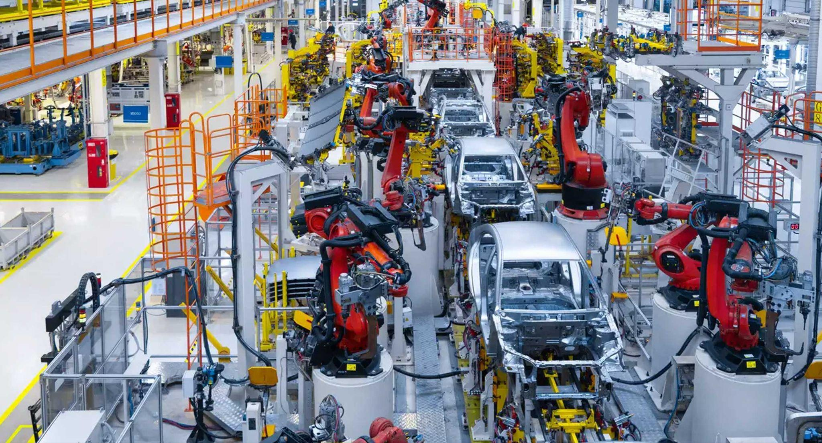
Automobile Industry Report Summary
The Indian automotive industry has one of the most significant contribution to the country's GDP. The industry has been growing at a rapid pace in recent years, driven by various factors such as rising income levels, increasing urbanization, and favorable government policies.
The Indian automotive industry is the third-largest automobile market in the world, after China and the United States. The industry is dominated by two-wheelers, which account for more than 80% of the total vehicles sold in the country. Passenger vehicles and commercial vehicles account for the remaining 20% of the market.
References:
https://www.ibef.org/industry/india-automobiles

Slide 15
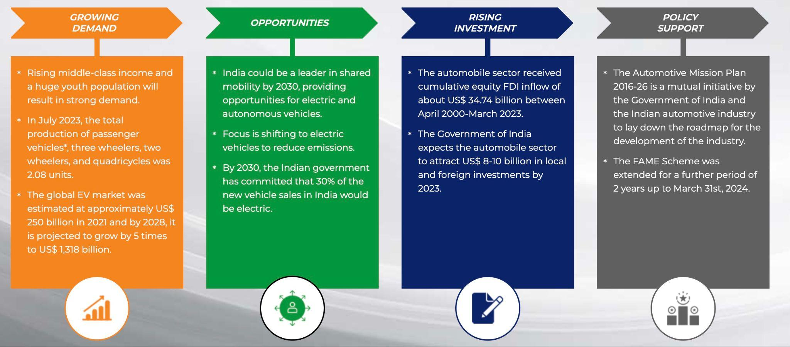

Slide 16
Growth Prospects:
According to the report, the Indian automotive industry is expected to reach $300 billion by 2026. The growth is driven by several factors such as rising incomes, urbanization and favorable government policies. The Indian government has taken various measures to encourage the growth of the auto industry, such as lowering taxes on electric vehicles and encouraging the development of charging infrastructure. Several key factors that are influencing the growth of the Indian automotive industry are:
Economic Growth: The growth of the automotive industry is closely tied to the overall economic health of the country. As India continues to experience economic growth, the demand for automobiles is likely to rise.
Rising Middle Class: The expanding middle class in India has more disposable income, contributing to increased consumer spending on automobiles.
Increasing Urbanization: Urbanization and the growth of cities lead to a higher demand for personal and commercial transportation.
Market Overview:
The Indian automobile industry is the third largest automobile market in the world after China and the United States. Two-wheelers dominate the industry, accounting for more than 80% of all vehicles sold in the country. Passenger cars and commercial vehicles make up the remaining 20% ​​of the market.
The Indian automobile industry is highly competitive, with both domestic and international players operating in the market. The industry is dominated by a few big players like Maruti Suzuki, Hyundai and Tata Motors. These players have a significant market share and Maruti Suzuki alone accounts for more than 50% of the passenger car market.

Slide 17
Recent Trends and Strategies:
The shift towards electric vehicles is one of the major trends in the Indian automotive industry. The Indian government has been taking various measures to promote the adoption of electric vehicles, such as reducing taxes on electric vehicles and providing incentives for the development of charging infrastructure. The industry players have also been investing in the development of electric vehicles, with many new electric vehicles being launched in the market in recent years.
Recent trends in the Indian automotive sector include a notable shift towards electric vehicles, the integration of advanced technologies such as artificial intelligence, machine learning, and the Internet of Things (IoT), and the emergence of new business models like car-sharing and ride-hailing. Industry players are responding by investing in research and development, expanding their product portfolios, and forming strategic partnerships to stay competitive
Growth drivers and opportunities:
The Indian automotive industry is driven by various factors such as rising income levels, increasing urbanization, and favorable government policies. The rising income levels and increasing urbanization are driving the demand for vehicles in the country. The favorable government policies such as reduced taxes on electric vehicles and incentives for the development of charging infrastructure are driving the growth of the electric vehicle market in the country.
Additionally, there are many prospects for expansion in the Indian automobile sector, including the creation of new technology, the expansion of product portfolios, and the entry into new markets. The development of new technologies such as electric vehicles, advanced driver assistance systems, and connected cars presents significant opportunities for growth in the industry. The expansion of product portfolios and the entry into new markets also present significant opportunities for growth in the industry.

Slide 18
The Industry report includes a comprehensive list of key contacts in the Indian automotive industry. These associations include industry associations, government agencies and industry players. Industry organizations such as the Society of Indian Automobile Manufacturers (SIAM) and the Auto Parts Manufacturers Association of India (ACMA) play an important role in promoting the growth of the industry. Government agencies such as the Ministry of Heavy Industries and Public Enterprises and the Ministry of Road Transport and Highways are responsible for developing policies and regulations for the sector. Industry players like Mahindra & Mahindra, Maruti Suzuki, Hyundai and Tata Motors are the major players in the industry and play a major role in driving the growth of the industry.
The export of autos had a significant increase, rising from 4,134,047 units in the fiscal year 2020-21 to 5,617,246 units in the fiscal year 2021-22, representing a notable growth rate of 35.9%.According to the Society of Indian Automobile Manufacturers (SIAM), the automotive sector creates jobs for 13 individuals each truck, 6 individuals per vehicle, 4 individuals per three-wheeler, and 1 individual per two-wheeler.The trucking market in India is projected to expand by more than four times by the year 2050. The number of trucks is projected to increase by more than four times, from 4 million in 2022 to over 17 million trucks by 2050.
CONCLUSION
In conclusion, the Indian automotive industry presents significant opportunities for growth, driven by a confluence of factors. The dynamic landscape, marked by a shift towards electric vehicles, technological advancements, and evolving business models, underlines the industry's potential for continued expansion.

